Slide 1



A DATA-DRIVEN APPROACH TO IMPROVING HOSPITAL OBSERVATION UNIT OPERATIONS
Project By
Sowndarya Saini
Goutham Yallapu

Slide 2
Introduction
Issue Overview
Data Dictionary
Exploratory Data Analysis
Data preprocessing
Model Development
Predictive Analysis
Recommendations
TABLE OF
CONTENT

Slide 3

INTRODUCTION
The hospital is situated in the city of Montanaro.
Consists of 260-bed healthcare facility and 23-bed Observation Unit (OU).
Led by Dr. Erin Kelly.
OU is an integral part of patient care management which is designed for the observation of patients presenting with complex, non-life-threatening symptoms, offering a crucial middle ground between the emergency department and inpatient admission.

Slide 4
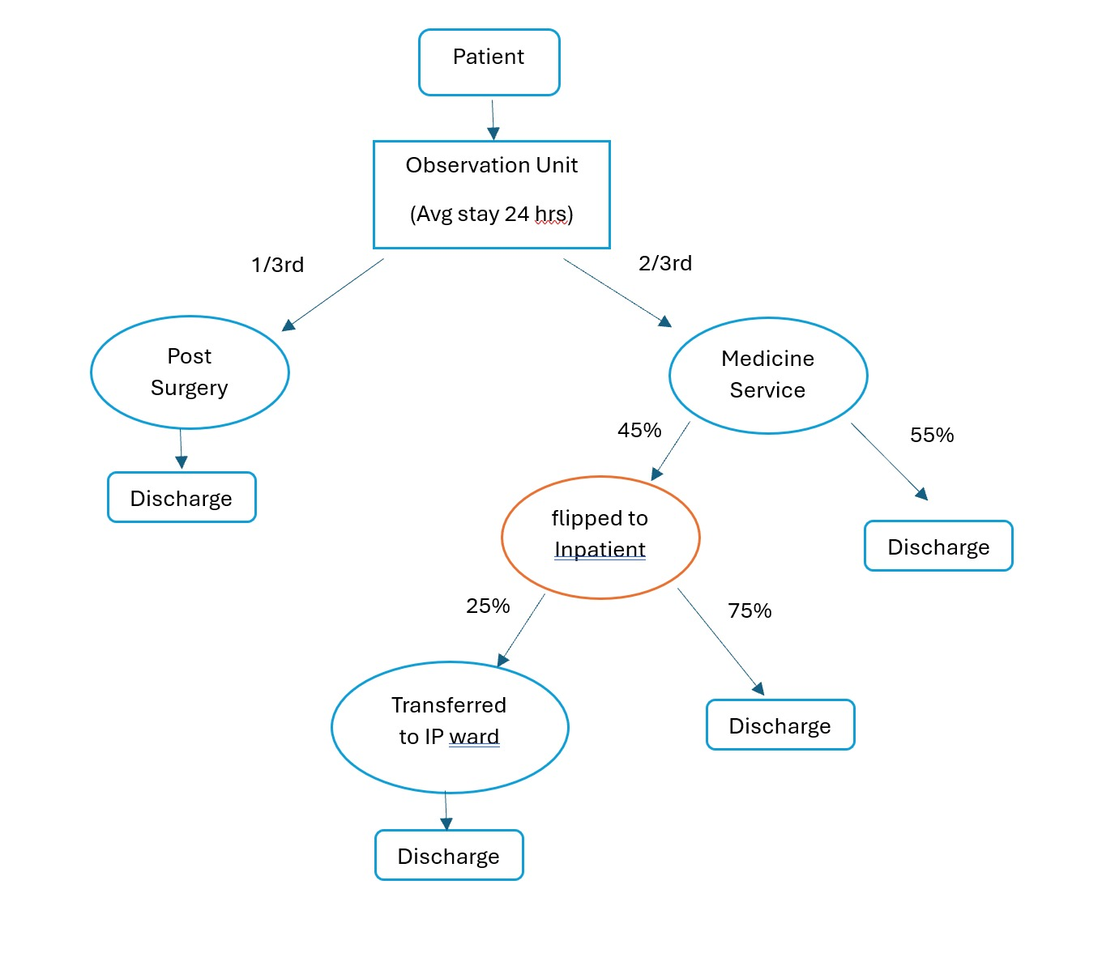
PROCESS FLOW

Slide 5

ISSUE OVERVIEW
Resource misallocation and extended stays
Job dissatisfaction among Observation Unit(OU) nurses
Overcrowding in the Emergency Department
Limited exclusion list
Low compensation by medical insurance provider

Slide 6
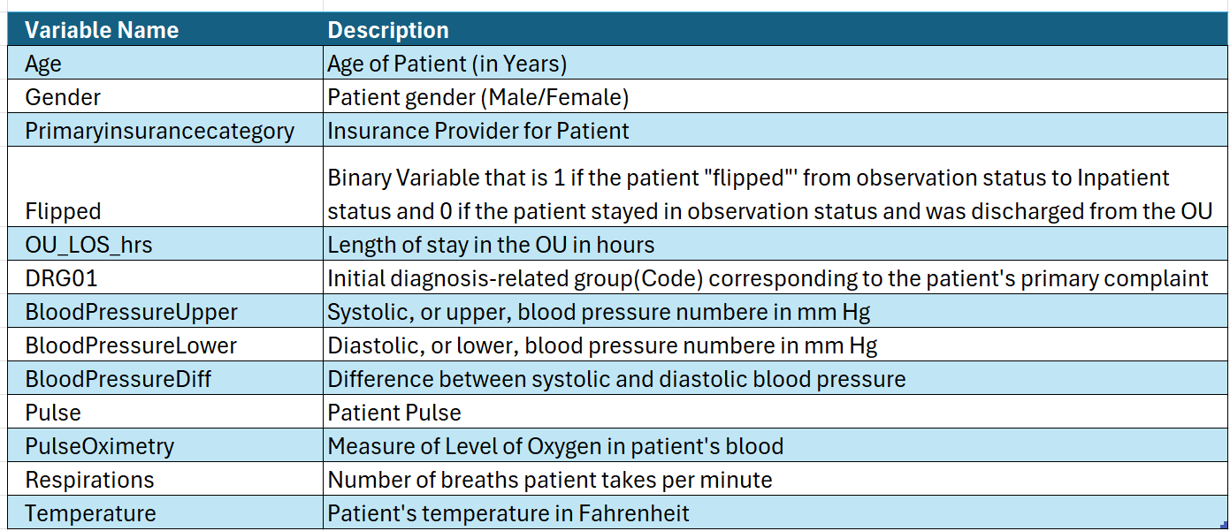
DATA DICTIONARY
Dataset consists of 1,111 observations and 15 Variables

Slide 7
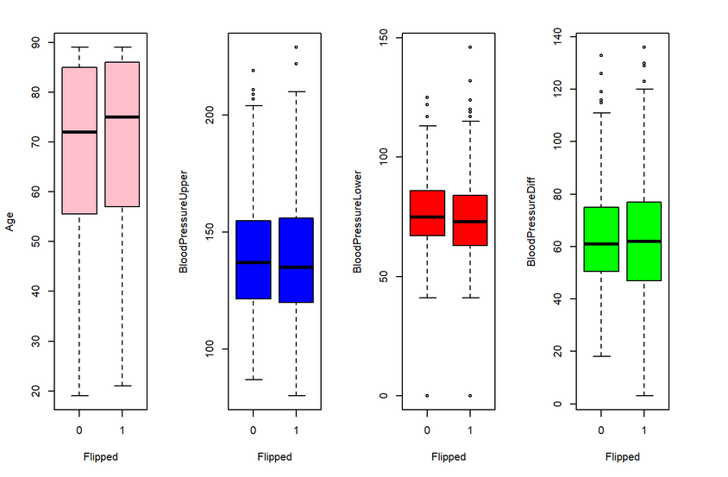
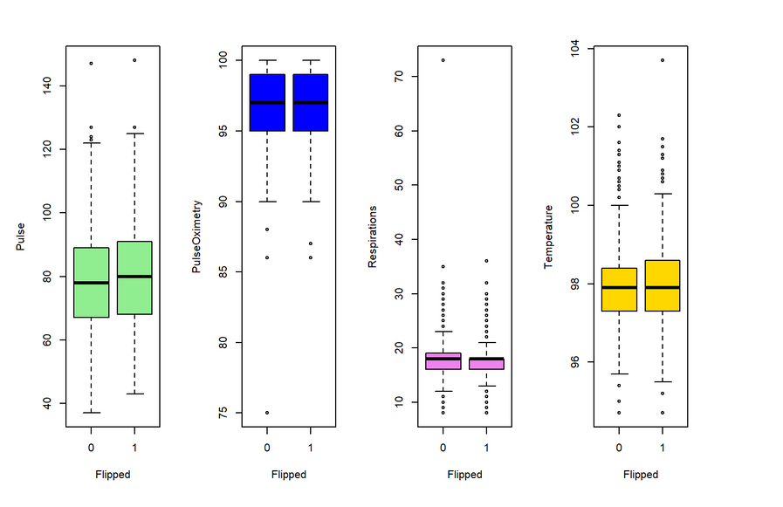
EXPLORATORY DATA ANALYSIS

Slide 8
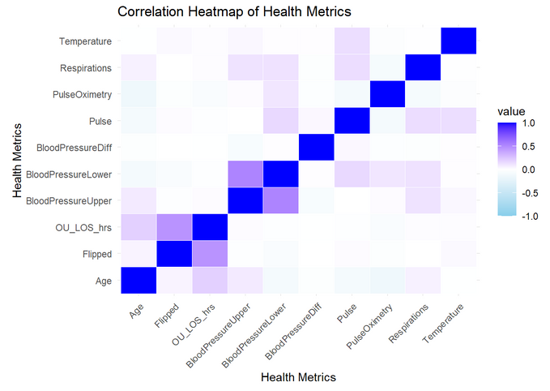
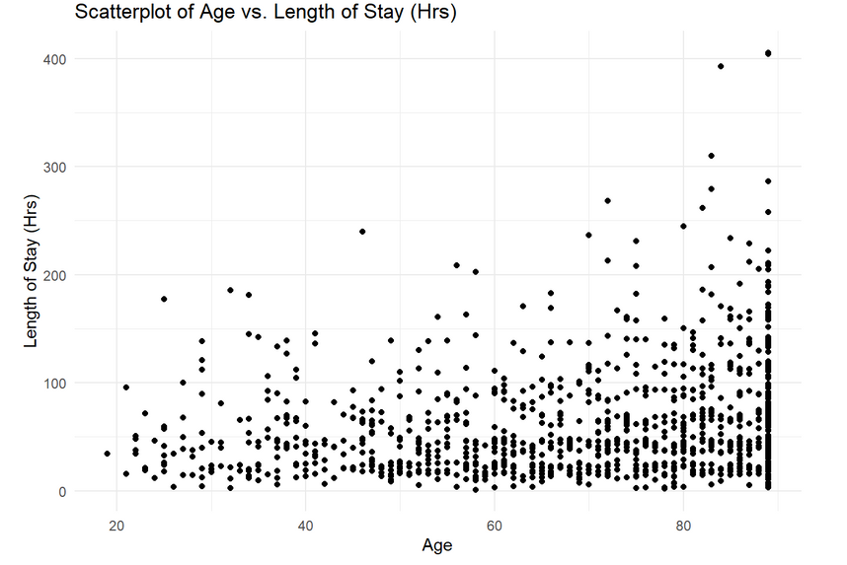
EXPLORATORY DATA ANALYSIS

Slide 9

DATA PREPROCESSING
Identification of missing values and outliers
Replacing missing values with mean or median
Correlation between variables to check multicollinearity
Data partitioning into training and testing datasets
Balancing the dataset
Normalization of variables

Slide 10

MODEL DEVELOPMENT
Utilizing a step-by-step approach, the following variables are taken into account while creating a model based on significance
Age
Respirations
PulseOximetry
DRG01
OU_LOS_hrs

Slide 11

PREDICTIVE ANALYSIS
Model | Accurancy | Baseline | Specificiy | Sensitivity | AUC
Logistic Regression Model | 76.28% | 53.75% | 87.15% | 63.64% | 83%
Random Forest Model | 78.08% | 53.75% | 75.98% | 80.52% | 78%

Slide 12

FINDINGS AND RECOMMENDATIONS
If Predictive model suggests that there is a high risk of flipping, a hospital should take the necessary safeguards and undertake additional study before converting to an inpatient ward.
If they can reduce flipped percentage from 45% to 20%, they will be able to serve more patients, increasing the Hospital’s topline and allowing them treatment of an additional 570 patients annually.
Implementing these models will enhance process improvement and improve job satisfaction among OU staff.
Reduce resource misallocation and extended stays in observation unit.
Expanding the exclusion list will decrease the likelihood of flipping.
Increase compensation from Insurance companies.

Slide 13
THANK YOU
Have any question?

Slide 14
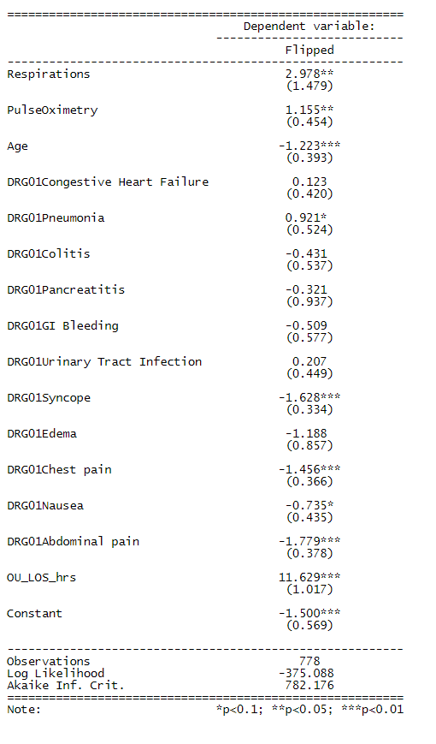
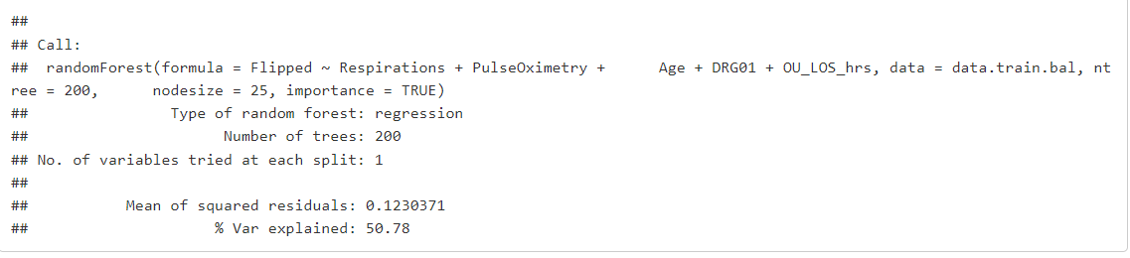
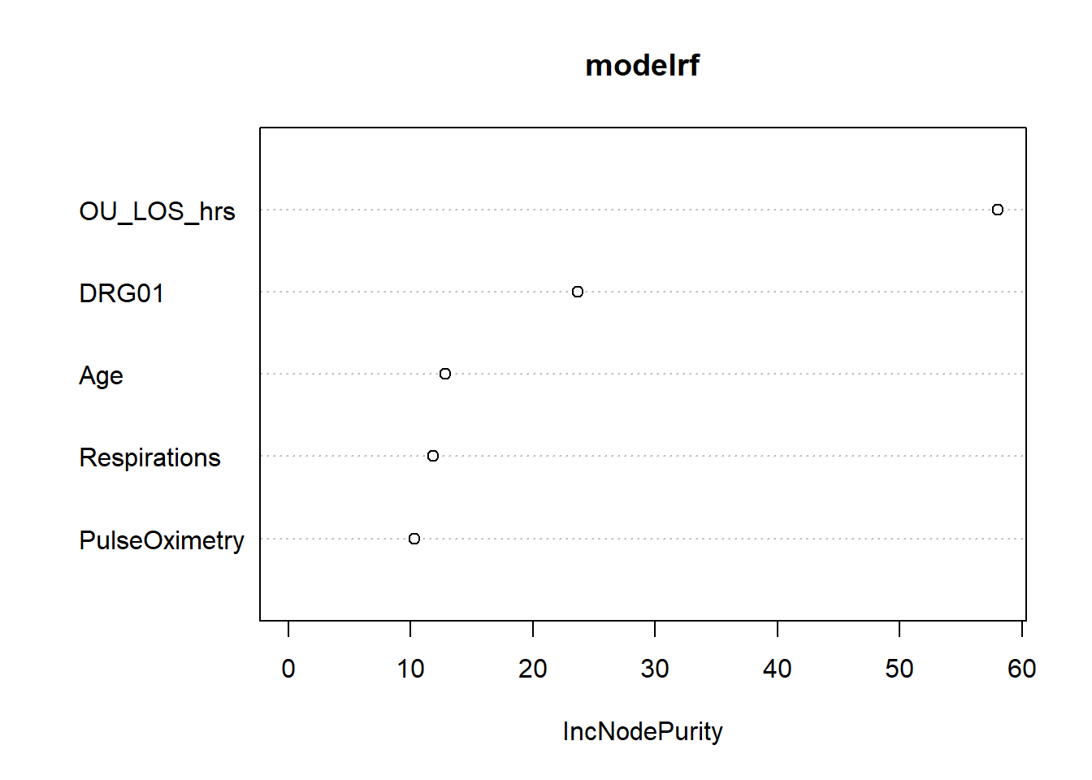
APPENDIX
Logistic Model output
Random Forest Model output
Variable Importance Plot

Slide 15
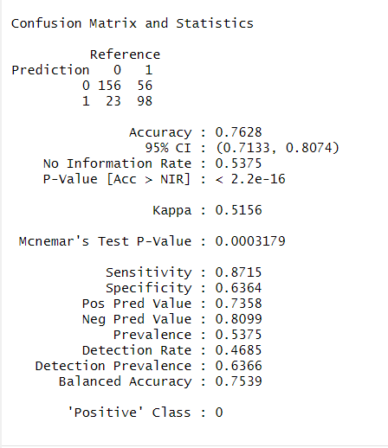
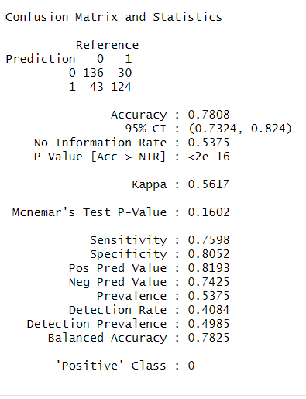
Confusion Matrix for Logistic Model
Confusion Matrix for Random Forest Model

Slide 16
